Slide 1

2021
1

Slide 2
Capstone Project

Slide 3
What is Capstone Project?
•You are required to Define, Design and Deliver a Data Science project towards the end of the course.
What are some Project milestones?
•~ -8 weeks: present 3 ideas for the project
•~ -6 weeks: decide on one option
•~ -5 weeks: collect data
•~ -4 weeks: present initial findings
•~ -2 weeks: present an update
•- 1 week: Dry run of final presentation
•Last day of course: Present final report

Slide 4
What to present?
Business perspective
Business insights uncovered
Business scenarios for how the project can be deployed and used
Approach for estimating business value
Technical perspective
Techniques used
Pipeline
Model validation results

Slide 5
Project Evaluation Criteria
The project is evaluated on the quality, clarity and completeness of the definition, design and delivery of the project.
Definition (20%)
Business context, stakeholders and value
Data description, sources, quality
Design (30%)
Data exploration, analysis and visualisation
Documentation: text document, presentation and Notebook
The project planning, effort allocation and next steps
Delivery (50%)
Feature Engineering
Creation of an effective reproducible pipeline
Machine Learning model algorithms and accuracy
Overall end-to-end solution
Delivery of the presentation, poise and audience engagement

Slide 6
Questions?

Slide 7
Presentation Structure

Slide 8
Agenda
Biography
Education
Professional Experience
Data Science learnings and experiences
Relevance to the project
Project Context
Industry / Domain
Problem area / statement
Why is this area interesting
Previous work in this area
Define
Business Aspects
Stakeholders
Business Question
Business Value
Data Science Aspects
Data Question
Data Required
Data Sourced
Design
Data exploration, analysis and visualisation
Overall flow used
Deliver
Feature Engineering
Machine models
Overall Solutions
Summary, conclusions and next steps

Slide 9
Project Title
Capstone Project
Presenter’s name and role (ideally Data Scientist)

Slide 10
Biography
Education
Professional experience
Data science learnings and experience
Relevance to the project

Slide 11
Project Context
Industry or domain
What is the current state of this industry? (e.g. challenges from startups)
What is the overall industry value-chain?
What are the key concepts in the industry?
Is the project relevant to other industries?
Problem area
What is the problem or the opportunity that the project is investigating?
Why is this problem valuable to address?
What is the current state (e.g. unsatisfied customers, lost revenue)?
What is the desired state?
Has this problem been addressed by other research projects? What were the outcomes?
Why is this area interesting?
Previous work in this area

Slide 12
Define
Business aspects
Stakeholders
Who are the stakeholders? (be as specific as possible)
Why do they care about this problem?
What are the stakeholders’ expectations?
Business question
What is the main business question that needs to be answered?
What is the business value of answering this question? (quantify value and make necessary assumptions)
What is the required accuracy? What are the implications of false positives or false negatives?
Business value
Data science aspects
Data question
What is the data question that needs to be answered?
What is the data required to answer the question?
Data required
Data sourced
Data source, description, volume and quality
How is the data generated?
How it can be sourced in the future?

Slide 13
Design
Data exploration, analysis and visualisation
Include one slide for the highlights of your Exploratory Data Analysis (EDA)
What data pipeline was to wrangle the raw data?
Is the pipeline reusable? (for example, to process future data?)
What are the intermediary data structures used (if any)?
Overall process flow used
See next slide

Slide 14
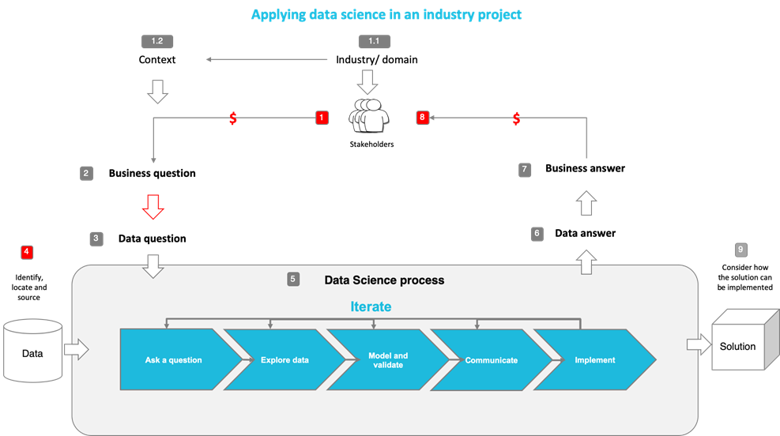
Design
Notes:
The following diagram shows the overall end-to-end process for defining, designing and delivering the Capstone project.

Slide 15
Deliver
Feature engineering
What are the most important features and what is the business significance
Machine models used and their evaluation metrics
How does the model fit in the overall solution
Who will use it?
When is it used?
How does it benefit the business?
What are the main features used?
Did you find any interesting interactions between features?
Is there a subset of features that would get a significant portion of your final performance? Which features?
How did you select features?
What feature engineering techniques are used?
What are the models used?
How long does it take to train your model?
What are the tools used? (cloud platform, for example)
What are the model performance metrics?
Which model was selected?

Slide 16

Summary, Conclusions and Next Steps
Summary
A brief recap of the presentation
Conclusions
What are the main findings and conclusions of the data science process?
Next steps
How can this project be developed further and implemented in real life?
What are the considerations for implementing the model in production?

Slide 17
Appendices
Where are the data and code used in the project? (show a simplified list of main items: notebooks, datasets, exported models)
What are the resources used in the project? (libraries, algorithms, etc)

Slide 18
Mini Project
The objectives of this mini-project is to:
Apply all what you have learned so far
Prepare you for the Capstone project
Understand your learning gaps
Please present as if it is your job interview take-away test on:
Business aspects of the project
Outcomes
Potential additional insights that can be obtained from available data
Data analysis and Machine Learning techniques used
Gaps in your skills
Please listen actively to your fellow classmate’s presentation and ask questions as if you are the hiring manager

Slide 19
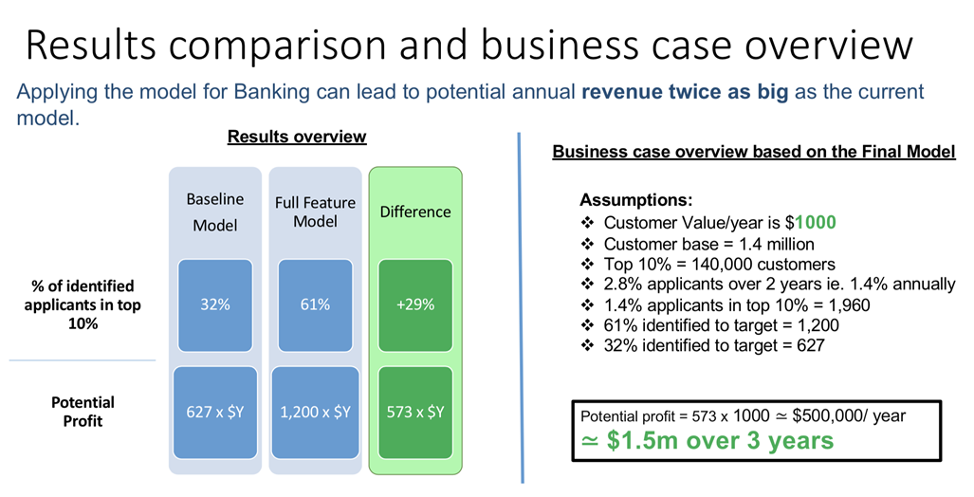
Case study: Home Loans Marketing

Slide 20
Appendices

Slide 21
Recommended modelling steps
Improving models:
1.Improve data
1.More data
2.Less NaN
3.Remove outliers
4.etc
2.Select your features
1.More features
3.Select algorithm
1.Make sure you compare at least 3
4.Hyperparameters tuning
1.Load data
2.Do minimal EDA
3.Use Dummy Classifier or Regressor (aka zero-information learning)
1.Use sckit-learn or do it by hand
4.Use a naive classifier or regressor (minimal learning). For example using 1 feature
5.Improve on the above and iterate

Slide 22
End of Presentation!

